Slide 1
Knight|Cast
Malicious Website
Identification
Domenico Vitale - Knight|Cast presentation 2021

Slide 2
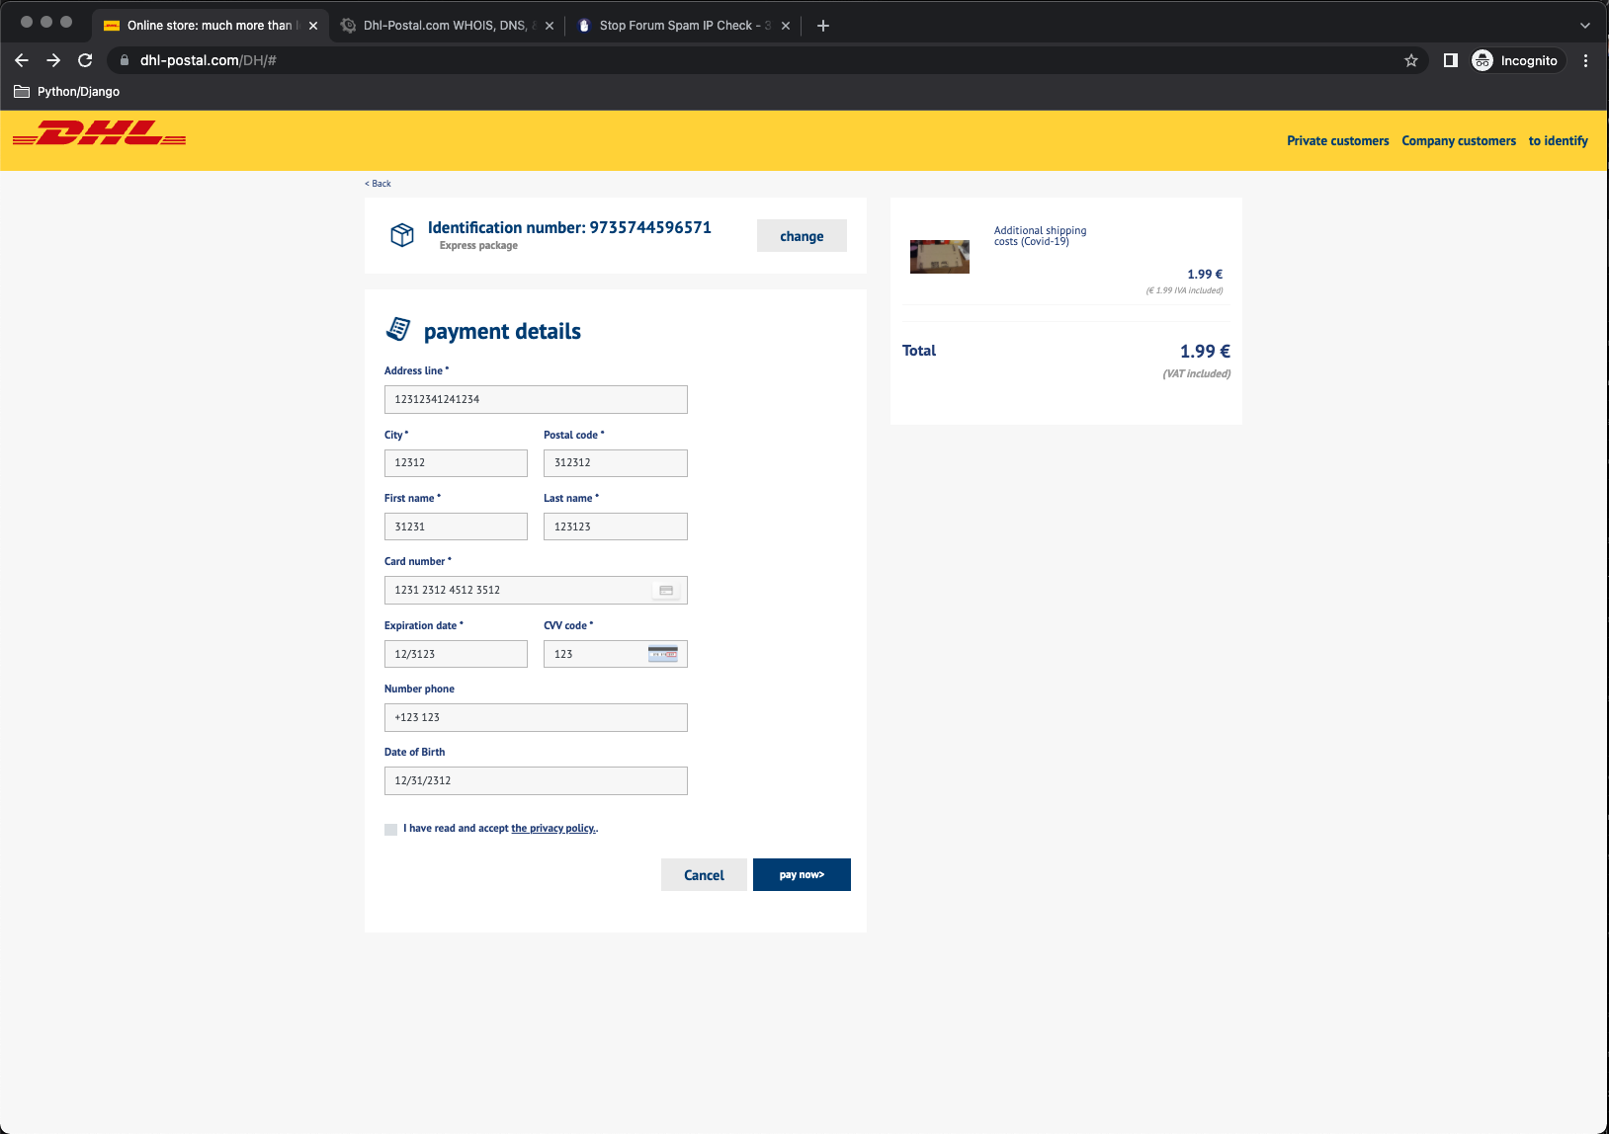
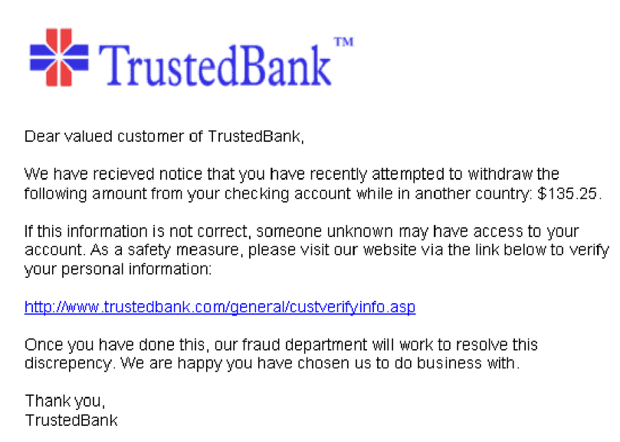
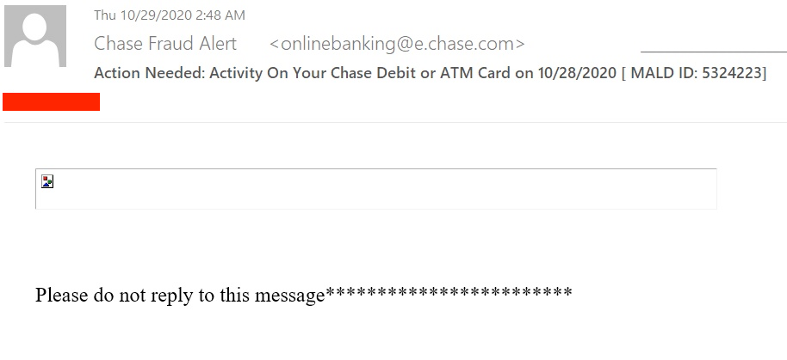
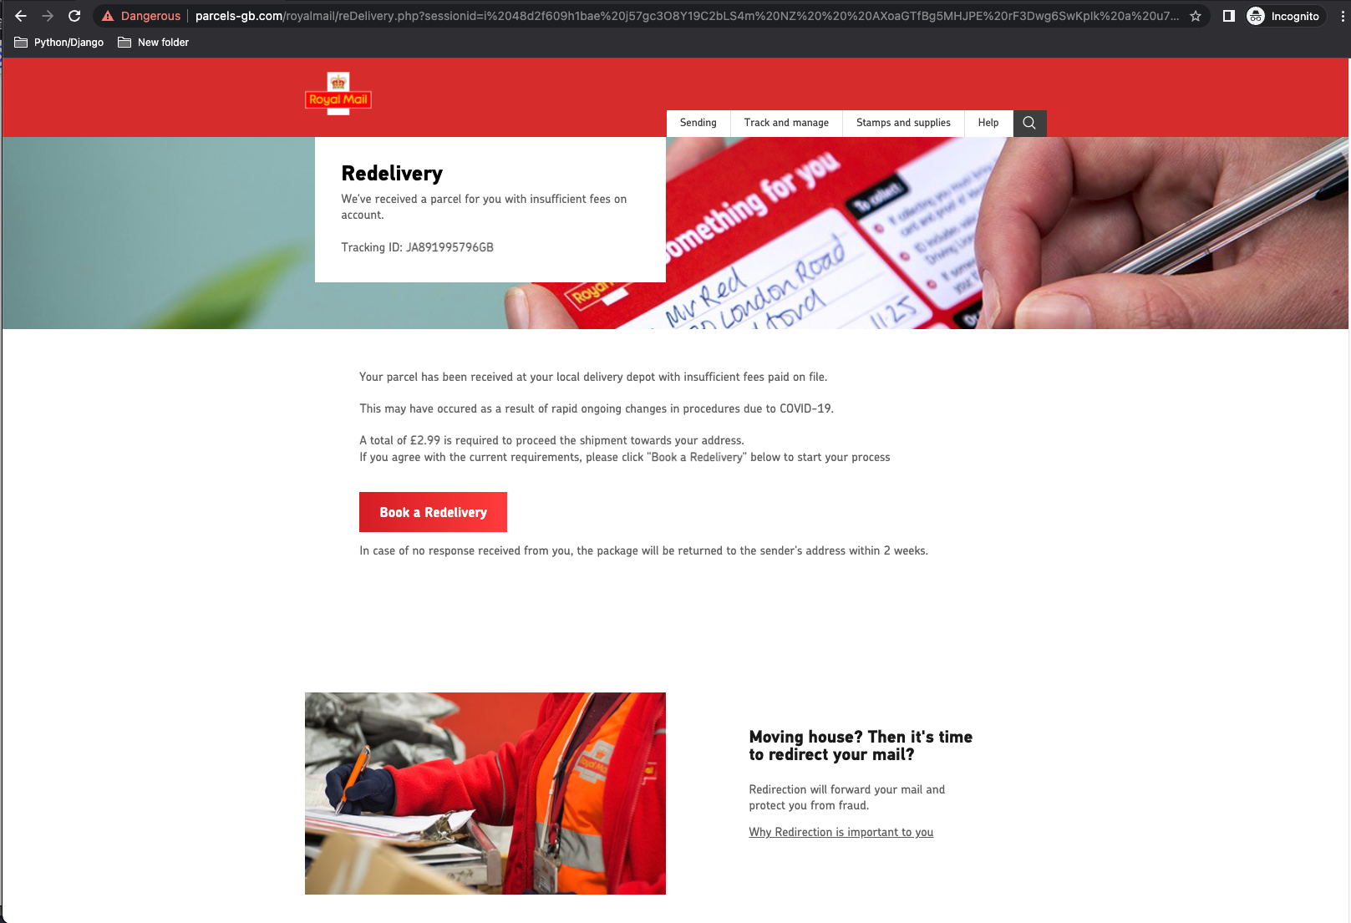
Malicious websites spoofs customers’ websites

Slide 3
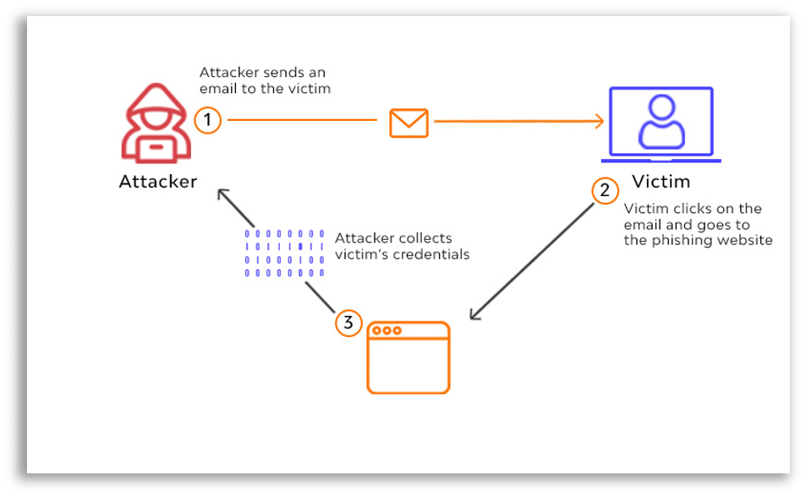

Slide 4

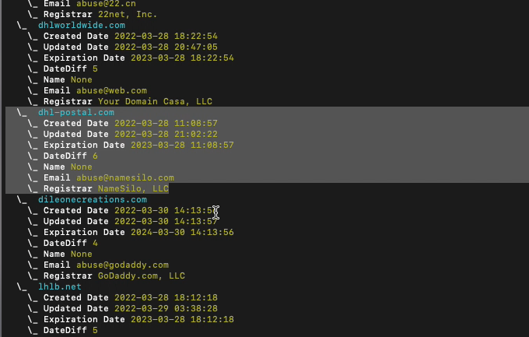
Website created within few minutes from the domain being available

Slide 5






Possible Threat Alert
Report
Brand Exploit Protect (BEP)
Review, Analysis and Report

Slide 6



Newly Registered Domains DB
Possible Threat
Domain info
Threat info
Previous reports
Knight|Cast
Possible Threat
Cross Reference
Report
Brand Exploit Protect (BEP)
Analysis
Data Platform

Slide 7
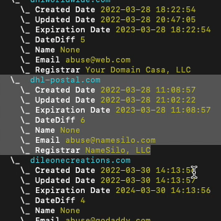
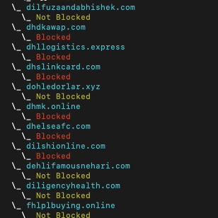
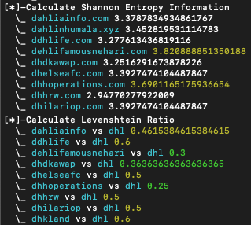
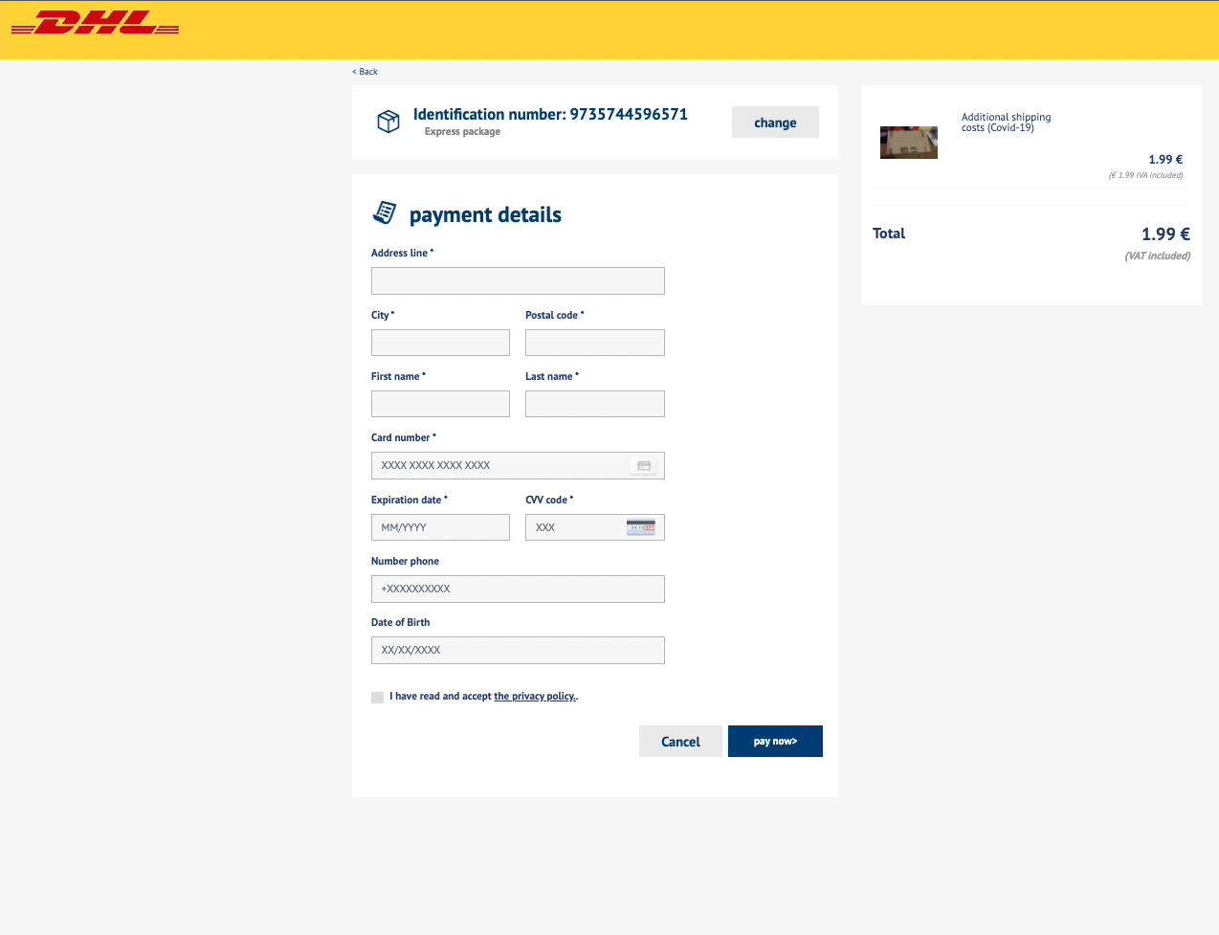
The proactive solution: Knight|Cast
Actively monitors newly generated domains based on list of keywords
Can be triggered manually or through other methods of notification
Use algorithmics approach and through QUAD9 and VirusTotal DB can identify potential threat within 2 minutes
Through website scrape and analysis can validate if the website is malicious within 2 to 5 minutes
Using Data Platform can cross-reference websites, domains, and hosting companies
Identify
First Validation
Algorithmic approach
Analysis

Slide 8
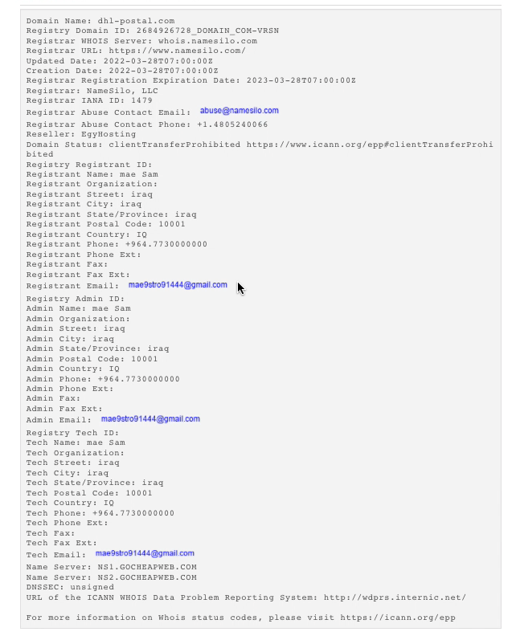
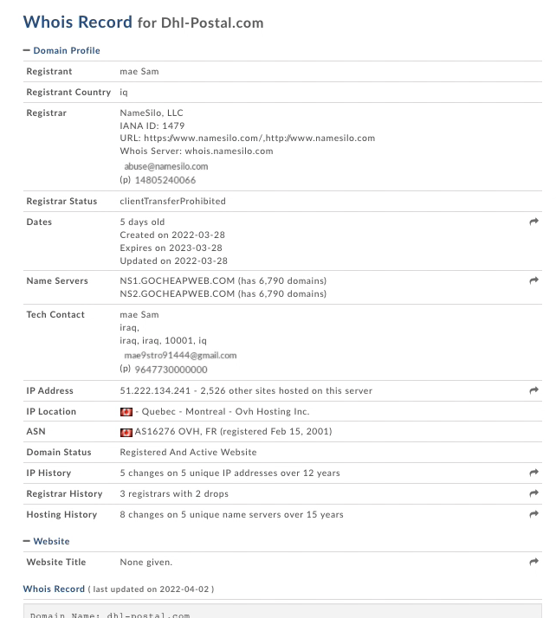

Slide 9
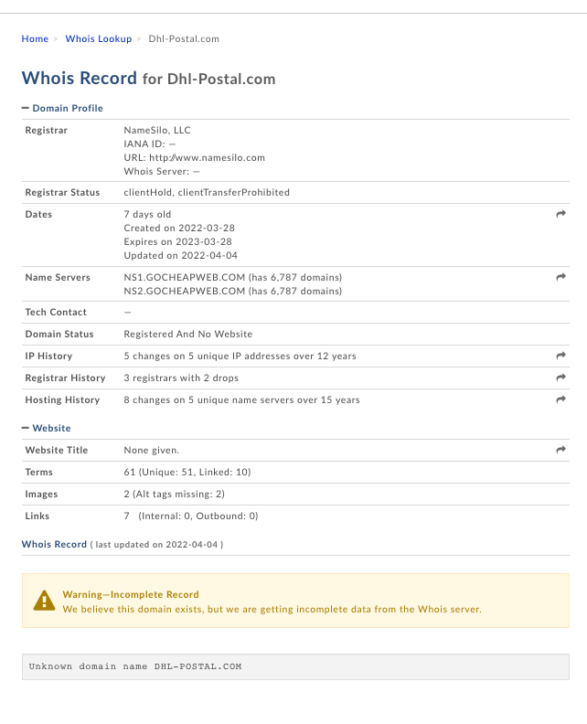
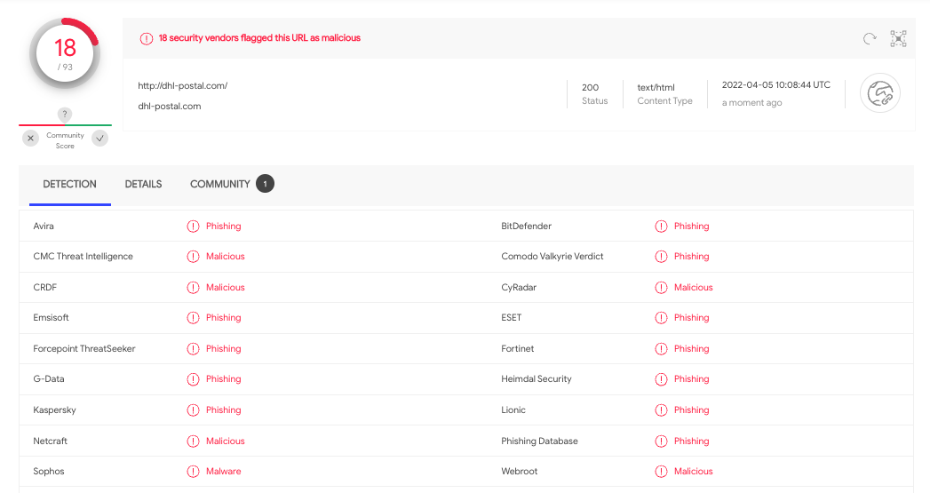

Slide 10
Newly Registered Domains DB
Possible Threat
Domain info
Threat info
Previous reports
Knight|Cast
Possible Threat
Cross Reference
Report
Brand Exploit Protect (BEP)
Analysis
Data Platform

Slide 11
Knight|Cast Impact
45%
TIME SAVED WITH TOOL AND MANUAL REVIEW AND REPORT
65%
TIME SAVED WITH TOOL AND AUTOMATIC REPORT

Slide 12
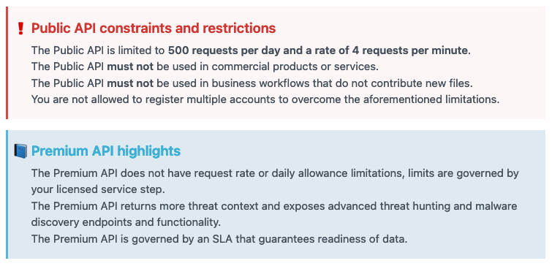
Current status
Review and update code for more robust web scraping
Current use of free VirusTotal API
Code for Data Platform cross-reference needed
Knight|Cast
VirusTotal API – Free VS Premium

Slide 13

Questions
Domenico Vitale - Knight|Cast presentation 2021

